Slide 1
Mesh Services and Accounts

Slide 2
Mesh Account
Is a collection of catalogs and spools
Is created by and belongs to the user
May be connected to a Mesh Service, this is not essential
It is much less useful

Slide 3
Mesh Service
Has a DNS address example.com
Is discovered using DNS discovery (SRV, TXT records)
So only the holder of the DNS name example.com can service it
Gives accounts an internet address alice@example.com
These are Internet addresses, not addresses being hijacked as names
Mesh Accounts can change their service
Example.com decides to charge $1,000 a year
Alice moves to example.net

Slide 4
All Mesh Protocols
Use DNS Discovery
Use JSON/JSON-B encoding
Use DARE Envelope for authentication
Support multiple transport protocols
Currently only HTTPS defined
Plan to add a UDP option in a QUIC idiom
Will come back to that
First contact is a Hello Message
Specify the service version, credentials etc
Enable a key exchange to authenticate the client

Slide 5
Mesh Client Protocol
Manages the account
Creation
Deletion
Manages connection of devices to Mesh accounts and personal Mesh
Connect
Complete
Manages synchronization of containers
Status
Upload
Download

Slide 6
InterMesh Protocol
Is used to pass Mesh Messages between Mesh Services
Post command
Four Corner model
Perform access control at ingress and egress

Slide 7
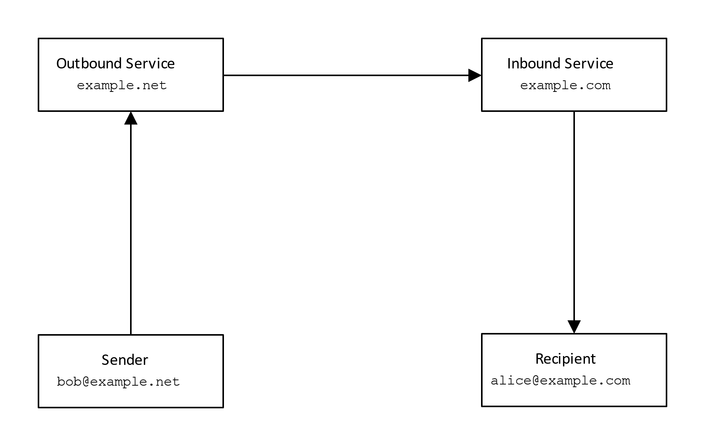

Slide 8
Triple Lock Security
Transport Layer
Provides confidentiality and protection against traffic analysis attack
Doesn’t provide end-to-end security in store and forward model
Message layer security
Provides end-to-end security
Enables access control
Doesn’t provide traffic analysis protection
Doesn’t provide data isolation
Data Level Security
Used for protection of private keys and contributions

Slide 9
And the future?
The Mesh is a platform that can be used to streamline application protocol design
Every part of the protocol using one consistent encoding
One approach to security
Same protocol compilers
Yes, there is more stuff to follow we don’t have to do it all
But these were used to sanity test the architecture
Also SSH, S/MIME, OpenPGP, etc.

